Slide 1
Problem solving with trigonometry
Trigonometry

Slide 2
How our teaching resources are designed for the classroom

Slide 3
I can use my knowledge of trigonometry to solve problems.

Slide 4
Trigonometric ratios
The trigonometric ratios are ratios between each pair of lengths in a right-angled triangle:
sin(θ°) = opposite cos(θ°) = adjacent tan(θ°) = opposite
hypotenuse hypotenuse adjacent

Slide 5

Problem solving with trigonometry
Calculating areas
Calculating angles

Slide 6

Calculating areas
To calculate the area of this triangle, we need to know the perpendicular height.
Pythagoras’ theorem and the trigonometric ratios require right-angled triangles.
16 cm
35°
Where can a right-angled triangle be created?
9 cm
Extending the base edge and dropping a perpendicular line.
16 cm
a cm
The area would be
35°
× 9 × a

Slide 7
Calculating areas
To calculate the area of this triangle, we need to know the perpendicular height.
Pythagoras’ theorem and the trigonometric ratios require right-angled triangles.
16 cm
35°
Where else can a right-angled triangle be created?
9 cm
Drawing an altitude of the triangle.
b cm
The area would then be
35°
× 16 × b
9 cm

Slide 8
Calculating areas
16 cm
16 cm
a cm
b cm
35°
35°
9 cm
9 cm
a = 16 × sin(35°)
b = 9 × sin(35°)
Area = × 9 × a
Area = × 16 × b
Area = × 9 × 16 × sin(35°)
Area = × 16 × 9 × sin(35°)
Area = 41.3 cm²
Area = 41.3 cm²
The two methods result in the same area.

Slide 9

Calculating areas
Which of the calculations are correct to find the perpendicular height of this triangle?
24 cm
21°
15 cm
h cm
12 × tan(21°) = h
a
15 × sin(21°) = h
b
h² + 12² = 15²
c
You cannot assume this is an isosceles triangle.

Slide 10
Calculating areas
The area of a parallelogram is calculated by finding the product of the perpendicular height and the base.
Area = 7 × 4.5 = 31.5 cm²
4.5 cm
Can the area be calculated if we do not know the perpendicular height?
7 cm
The perpendicular height is fixed throughout the parallelogram.
5.1 cm
h cm
h cm
h cm
h cm
h cm
62°
This position, creates a right-angled triangle with hypotenuse of 5.1 cm and an angle of 62°.
7 cm

Slide 11
Calculating areas
Using this right-angled triangle and the sine function, the perpendicular height of the parallelogram can be calculated.
5.1 cm
h cm
62°
7 cm
h = 5.1 × sin(62°)
h = 4.5…
Area = 7 × 4.5… = 31.5 cm² (1 d.p.)

Slide 12
Calculating areas
Alternatively the 5.1 cm edge could be the base of the parallelogram.
Calculate the length of this perpendicular height.
5.1 cm
h cm
62°
h = 7 × sin(62°)
7 cm
h = 6.18… = 6.2 cm (1 d.p.)
The area would be the same. Area = 5.1 × 6.18… = 31.5 cm² (1 d.p.)

Slide 13
Calculating areas
A regular octagon has edge lengths of 10 cm.
Is it possible to calculate the area of the octagon?
10 cm

Slide 14
Calculating areas
By sectioning it into other polygons.
135°
There are three different polygons in this sectioning.
A
B
A
10 cm
A
right-angled triangle
B
C
B
B
rectangle
A
B
A
C
square
45°
10 cm
C
10 cm
x cm
x cm
B
A
x cm
10 cm
10 cm

Slide 15
Calculating areas
By sectioning it into other polygons.
135°
There are three different polygons in this sectioning.
A
B
A
10 cm
A
right-angled triangle
B
C
B
B
rectangle
A
B
A
C
square
45°
x = 10 × cos(45°) = 7.07 (2 d.p.)
10 cm
x cm
A
Is there any other way to calculate the length of x?
x cm
Using the sine function or Pythagoras’ theorem.

Slide 16
Calculating areas
By sectioning it into other polygons.
135°
There are three different polygons in this sectioning.
A
B
A
A
right-angled triangle
area = 25 cm²
B
C
B
10 cm
B
rectangle
area = 70.71… cm²
A
B
A
square
C
area = 100 cm²
45°
7.07… cm
10 cm
7.07… cm
C
10 cm
B
A
7.07… cm
10 cm
10 cm
Area of octagon = 4 × 25 + 4 × 70.71… + 100 = 482.84 cm² (2 d.p.)

Slide 17
Calculating areas
By surrounding it by a square.
The length of the square is (10 + 2x) cm.
x cm
135°
45°
10 cm
x = 10 × sin(45°) = 7.07…
x cm
10 cm
so the length of the square is 24.14… cm.
and the area of the square is 582.84… cm².
The area of the octagon is the area of the square minus the area of the four congruent triangles.
Area = 582.84… - 4 × (0.5 × 7.07… × 7.07…) = 482.84 cm² (2 d.p.)

Slide 18
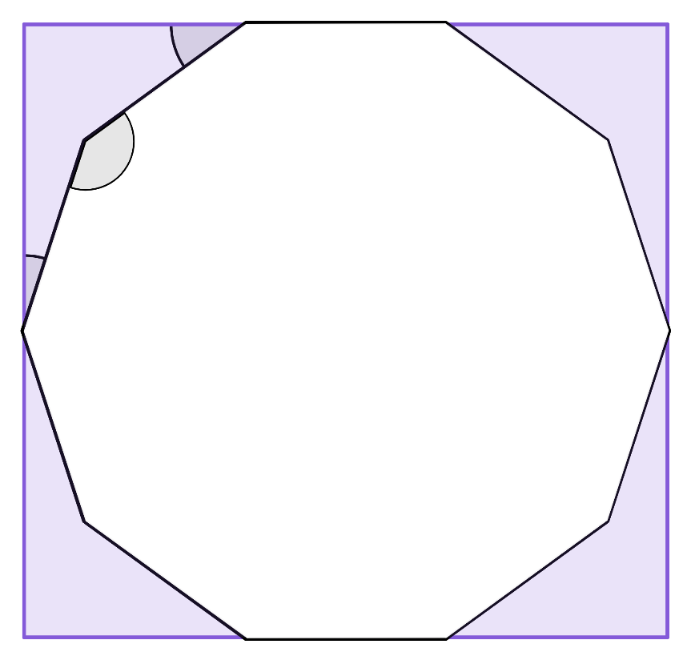

Calculating areas
This regular decagon has been surrounded by a rectangle.
8 cm
Match the calculation to the correct length on the diagram.
36°
b
a
8 × sin(18°)
a
144°
18°
8 × cos(36°)
c
b
8 × cos(54°)
c

Slide 19
Calculating areas
1) Calculate the area of each triangle, to 1 decimal place.
a)
b)
c)
d)
30°
12 cm
30°
12 cm
24°
82°
7 cm
6 cm
6 cm

Slide 20
Calculating areas
2) Calculate the area of this rhombus, to 1 decimal place.
7 cm
73°
3) Calculate the area of this parallelogram, to 1 decimal place, given that its perimeter is 54 cm.
11 cm
66°

Slide 21

Calculating areas
4) Calculate the area of this regular hexagon, to 1 decimal place.
5 cm

Slide 22
Calculating areas
1) Calculate the area of each triangle, to 1 decimal place.
a)
h = 3 × tan(82°) = 21.346…
Area = × 6 × 21.346… = 64.0 cm²
h cm
82°
6 cm

Slide 23
Calculating areas
1) Calculate the area of each triangle, to 1 decimal place.
b)
15°
h = 3 ÷ tan(15°) = 11.196…
Area = × 6 × 11.196… = 33.6 cm²
h cm
6 cm

Slide 24
Calculating areas
1) Calculate the area of each triangle, to 1 decimal place.
c)
h = 7 × sin(24°) = 2.847…
Area = × 12 × 2.847… = 17.1 cm²
h cm
12 cm
24°
7 cm

Slide 25
Calculating areas
1) Calculate the area of each triangle, to 1 decimal place.
d)
h = 12 × sin(30°) = 6
30°
Area = × 12 × 6 = 36 cm²
12 cm
h cm

Slide 26
Calculating areas
2) Calculate the area of this rhombus, to 1 decimal place.
h cm
7 cm
73°
7 cm
h cm
h = 7 × sin(73°) = 6.694…
73°
Area = 7 × 6.694… = 46.9 cm²

Slide 27
Calculating areas
3) Calculate the area of this parallelogram, to 1 decimal place, given that its perimeter is 54 cm.
h cm
11 cm
66°
b cm
Perimeter: 2b + 22 = 54
h = 11 × sin(66°) = 10.049…
2b = 32
b = 16
Area = 16 × 10.049… = 160.8 cm²

Slide 28
Calculating areas
4) Calculate the area of this regular hexagon, to 1 decimal place.
5 cm
A possible method:
5 cm
y cm
x = 5 × cos(60°) = 2.5
x cm
60°
y = 5 × sin(60°) = 4.33…
5 cm
2y cm
Area of rectangle = (2 × 4.33…) × (5 + 2 × 2.5) = 86.602… cm²
120°
Area of 4 congruent triangles = 4 × × 2.5 × 4.33…= 21.650… cm²
(5 + 2x) cm
Area of hexagon = 86.602… - 21.650 = 65.0 cm²

Slide 29
Problem solving with trigonometry
Calculating areas
Calculating angles

Slide 30
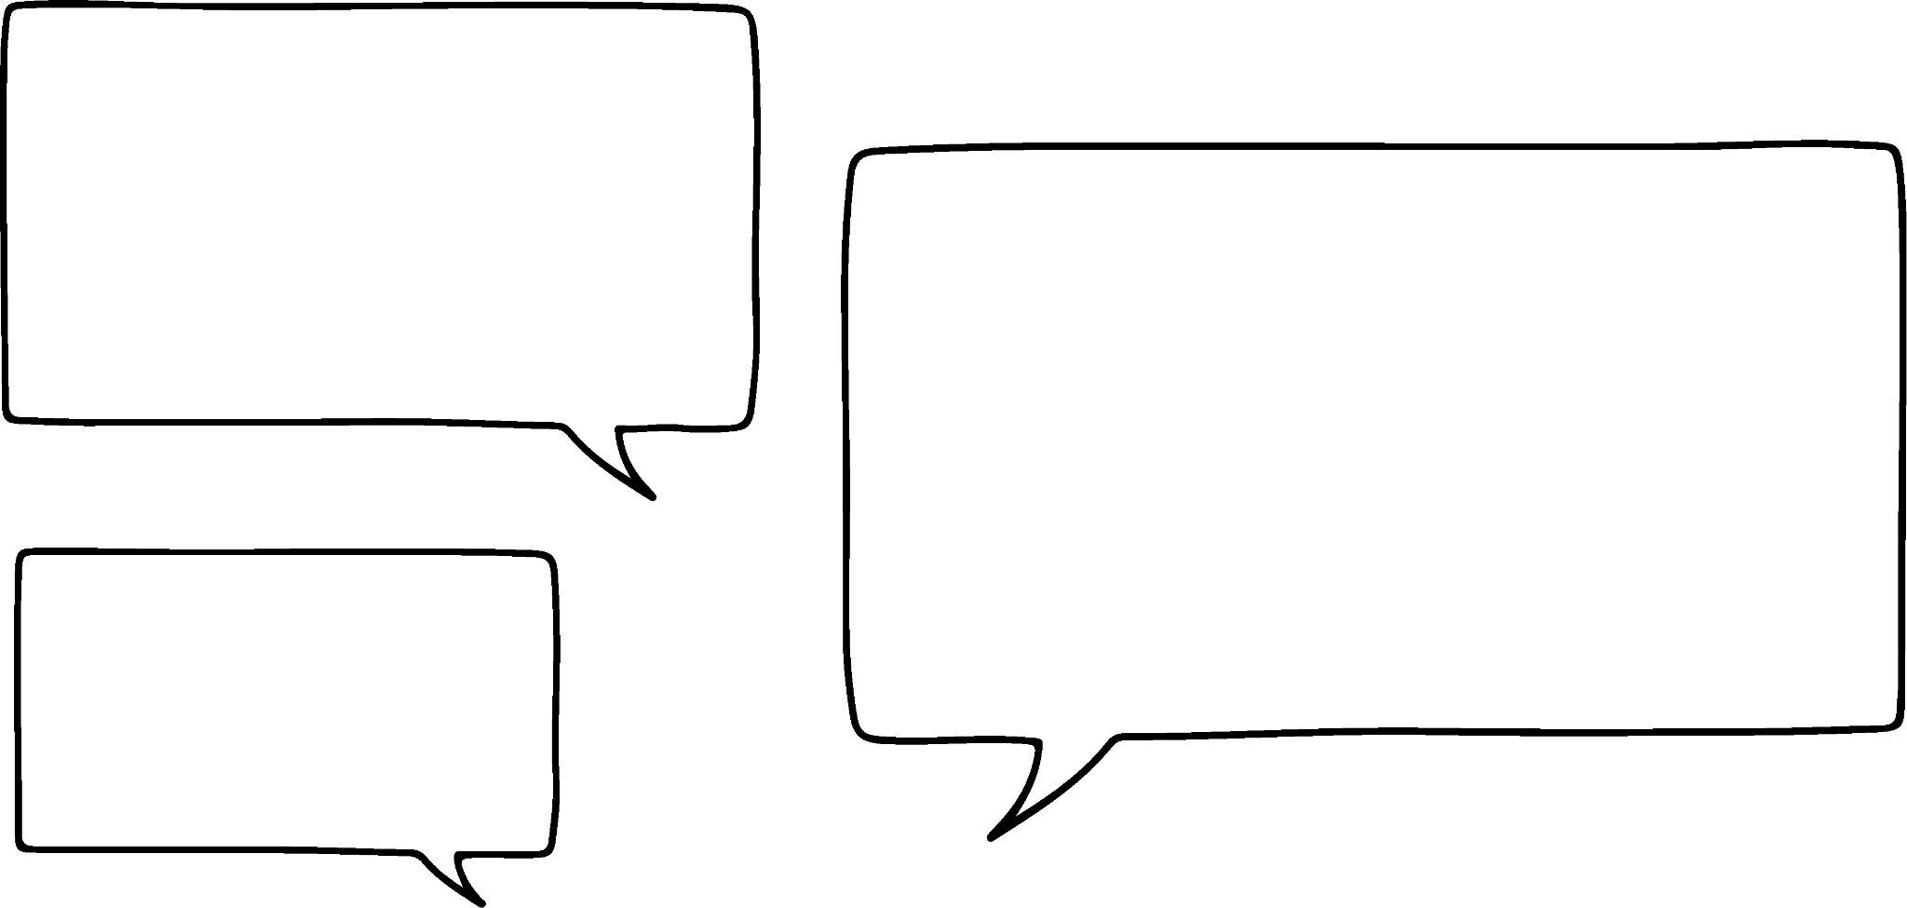
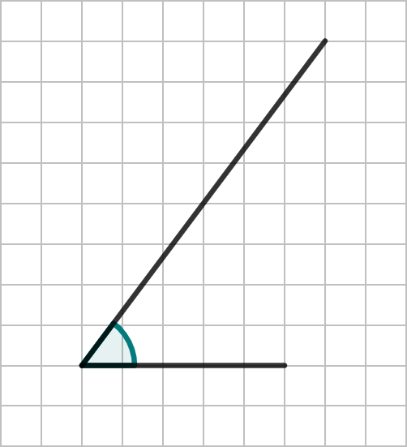

Calculating angles
Without the use of a protractor, how can the size of the angle be established?
If we know two edges of a right-angled triangle then we can calculate it.
Can you see a right-angled triangle?
𝜃°
Jun
Which one is the most accurate?

Slide 31
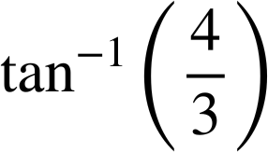
Calculating angles
This one, as its base edge is an integer and the vertical edge is an integer. There is no estimation of length, which increases error margins.
These two edges are part of the tangent function.
4
tan(𝜃°) =
3
4
𝜃° =
𝜃°
Jun
𝜃° = 53.1° (1 d.p.)
3

Slide 32
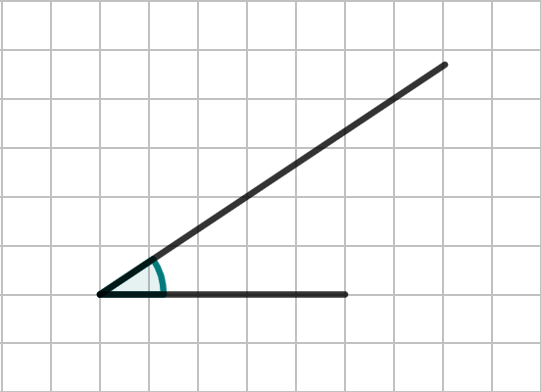
Calculating angles
Which right-angled triangle would be the most accurate to use to calculate the angle 𝜃°?
𝜃°
𝜃°
𝜃°
a
b
c

Slide 33
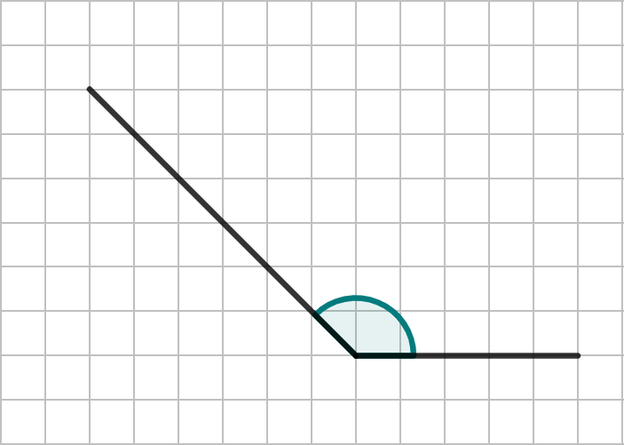
Calculating angles
Can a similar method be used for this obtuse angle?
I think you can create a right-angled triangle.
𝜃°
Do you agree with Jun?
There is more than one place that a useful right-angled triangle can be drawn.
Jun

Slide 34
Calculating angles
Can a similar method be used for this obtuse angle?
This triangle means we can calculate the angle 𝛼 and then subtract it from 180°.
𝜃°
𝛼°

Slide 35
Calculating angles
Calculate the angle 𝜃.
4
tan(𝛼°) =
4
𝛼° = tan⁻¹ (1)
4
𝜃°
𝛼° = 45°
𝛼°
4
𝜃° = 180 - 45 = 135°

Slide 36
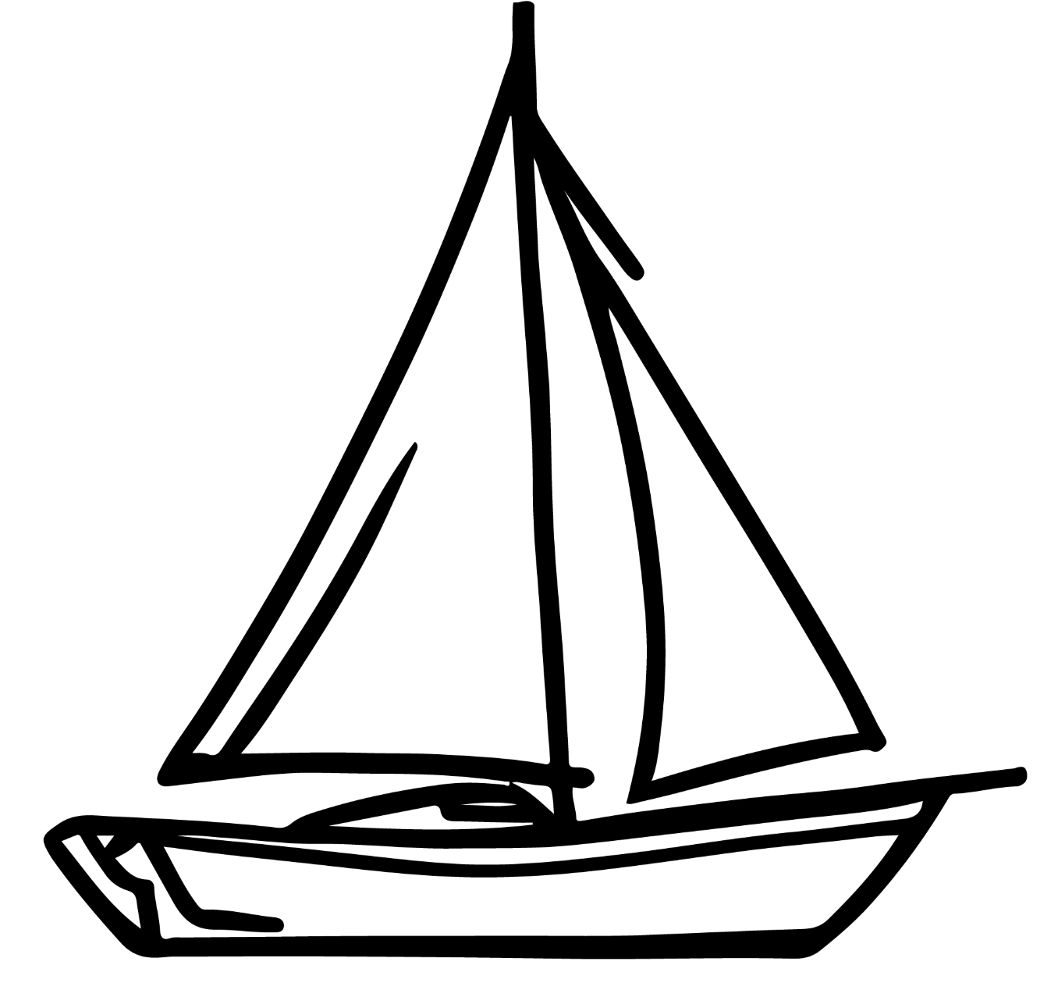
Calculating angles
A yacht leaves a port and travels 60 km due East and then 40 km due South.
port
If another yacht was to leave the port, facing East and travel directly towards the first yacht, what angle should it turn through?
1
2
60 km
1
𝜃°
40 km
40
tan(𝜃°) =
1
60
𝜃° = tan⁻¹ (0.66…)
𝜃° = 33.7° (1 d.p.)

Slide 37
Calculating angles
A yacht is given the instruction to sail 30 km due East and then 50 km due South. If the yacht is already facing East, what angle could it turn to be facing directly towards its final position?
port
30 km
50
tan(𝜃°) =
30
𝜃°
𝜃° = tan⁻¹ (1.66…)
50 km
𝜃° = 59.0° (1 d.p.)

Slide 38
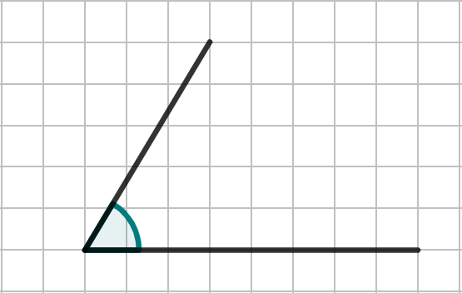
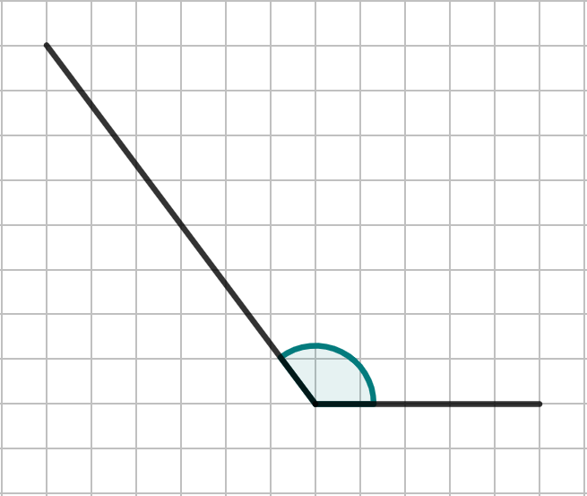
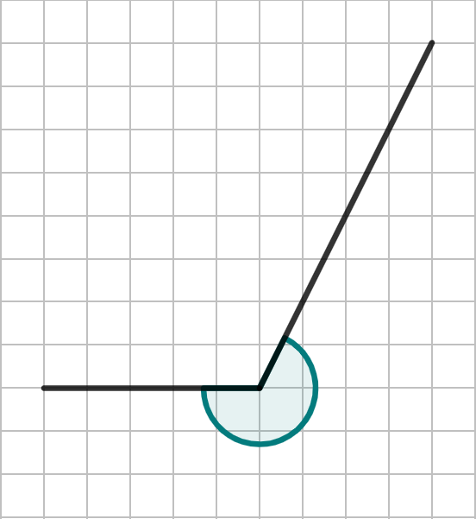
Calculating angles
1) Calculate the marked angles on each diagram.
a)
b)
c)
𝜃°
𝜃°
𝜃°

Slide 39
Calculating angles
2) A yacht is given the instruction to sail 20 km due East and then 60 km due North. If the yacht is already facing East, what angle should it turn to be facing directly towards its final position?
3) A helicopter travels 30 km due North and then rotates 𝜃°, before travelling 50 km in that direction. The helicopter finishes directly due West of the starting point. What angle of turn did they make?

Slide 40
Calculating angles
1) Calculate the marked angles on each diagram.
a)
b)
c)
𝜃°
𝜃°
𝜃° = 59.0° (1 d.p.)
𝜃°
𝜃° = 126.9° (1 d.p.)
𝜃° = 243.4° (1 d.p.)

Slide 41
Calculating angles
2) A yacht is given the instruction to sail 20 km due East and then 60 km due North. If the yacht is already facing East, what angle should it turn to be facing directly towards its final position?
60
tan(𝜃°) =
60 km
20
𝜃°
𝜃° = tan⁻¹(3)
20 km
𝜃° = 71.6° (1 d.p.)

Slide 42
Calculating angles
3) A helicopter travels 30 km due North and then rotates 𝜃°, before travelling 50 km in that direction. The helicopter finishes directly due West of the starting point. What angle of turn did they make?
𝜃°
30
cos(⍺°) =
50
50 km
⍺°
30 km
⍺° = cos⁻¹(0.6)
⍺° = 53.13…°
𝜃° = 180 - ⍺ = 180 - 53.13… = 126.9°

Slide 43
Problem solving with trigonometry
Trigonometry can be applied in many different problems in mathematics.
When faced with a problem, always begin by considering the information you have been given and what can be found from it first.

Slide 44

© Oak National Academy 2024.
Produced in partnership with Mathematics in Education and Industry.
Licensed on the Open Government Licence v3.0, except where otherwise stated. See Oak terms and conditions.

